Slide 1
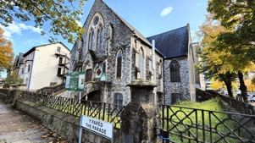
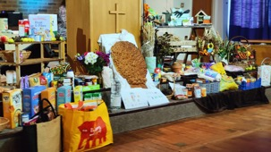
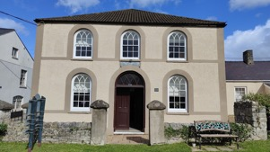
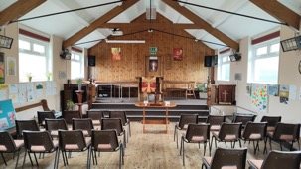
Home Mission Sunday 19th November 2023

Slide 2
Home Mission giving supports people, projects and ministries across South Wales

Slide 3
How big is SWBA and where are all our churches?

Slide 4
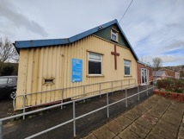
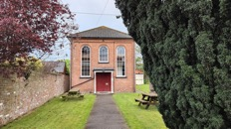
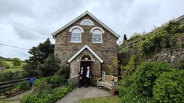
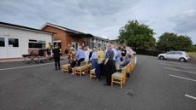
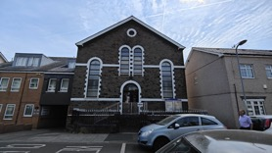
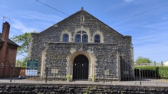
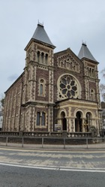
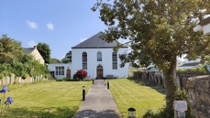
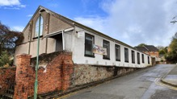
Here’s a map of more than 120 SWBA churches across South Wales!!

Slide 5
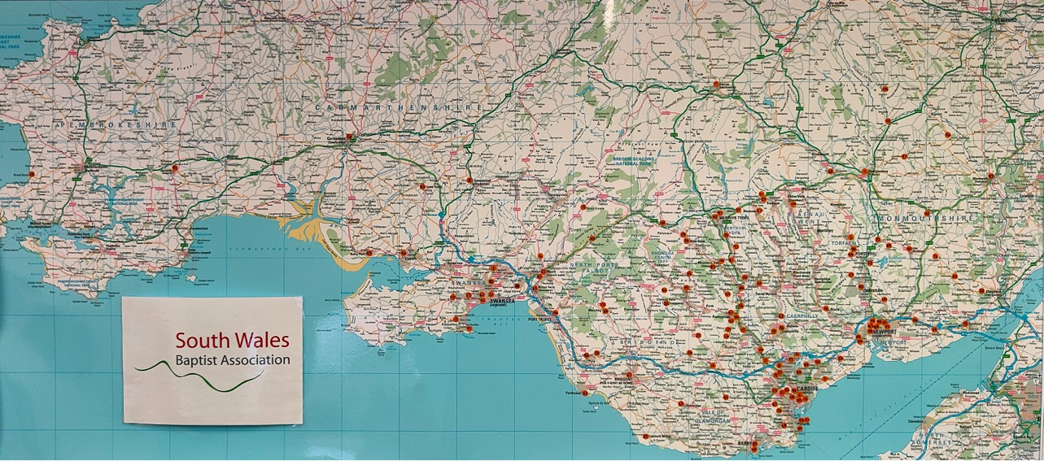

Slide 6
Who is in the association team?

Slide 7
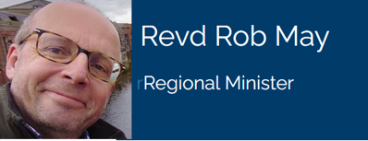
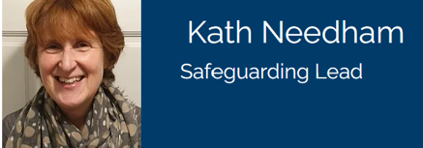
Introducing the Regional Team

Slide 8
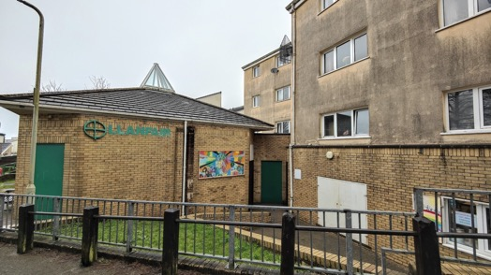
What ministries and projects have we supported this year?

Slide 9
York Place Baptist Church, Swansea
Llanfair Uniting Church, Penrhys
Rev Nick Bradshaw, Missioner to Outdoor Pursuit Community
Rev Naomi Dickerson, Renew Wellbeing Spaces
Chaplaincy Services at South Wales University
Rev Jon Vaughan-Davis, Digital Media Lead
Plus, various one-off grants throughout the year
And there’s always room for more…!!!

Slide 10
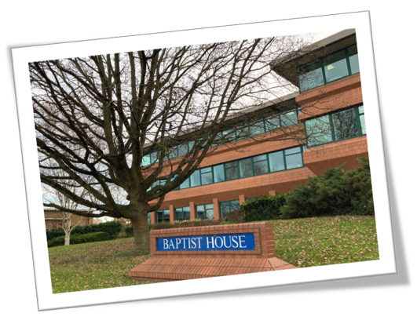
Home Mission also supports the national team based at Didcot

Slide 11
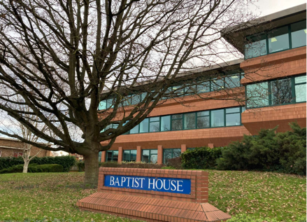
How many members of staff are based at Baptist House in Didcot?
20 full-time and 19 part-time staff
In four main Teams:
Ministries Team
HR and Safeguarding Team
Faith and Society Team
Support Services Team including the Legal and Operations Team!

Slide 12
Our SWBA Fundraising targets!
What’s our association fundraising target for 2023?
£150,000
How much had we raised by the end of August?
£92,607
How much had we raised by the same time last year?
£102,120

Slide 13
A very big thank you to everyone who has prayed and given to home mission this year. We couldn’t do all this without you and your support!! Please give as generously as you can…

